Slide 1
Init & simple drawing

Slide 2
Objectives
Create a skeleton DirectX 10 project
Understand game loop
Render a sprite
Create simple movement

Slide 3
Set up sample project on VS2019
Create C++ | Windows | Desktop | Empty project
Link to D3D10 lib
Install D3D10X lib using NuGet
Hide unrelated debug messages

Slide 4
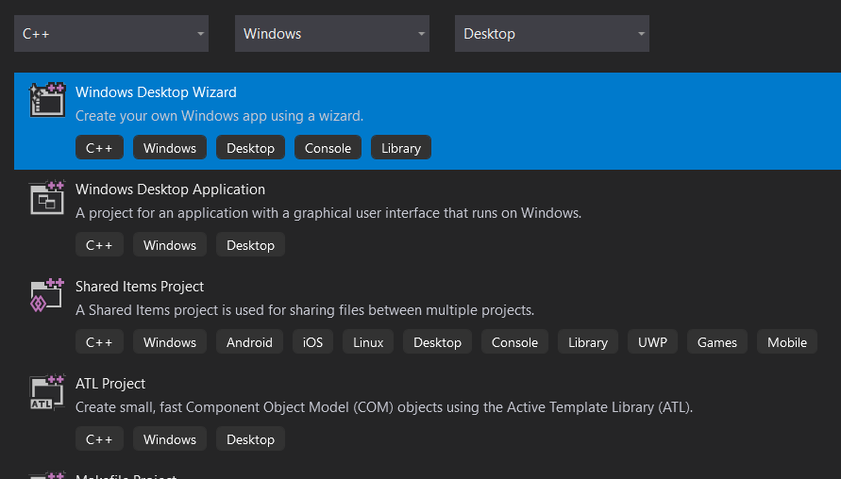
Create an empty project

Slide 5
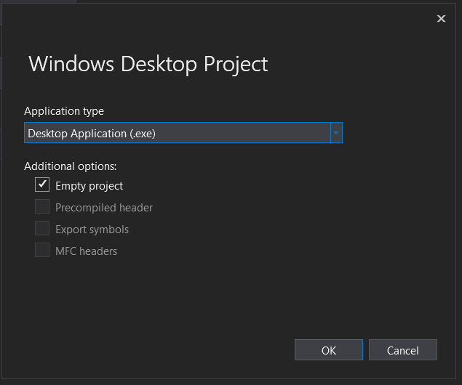
Create an empty project

Slide 6
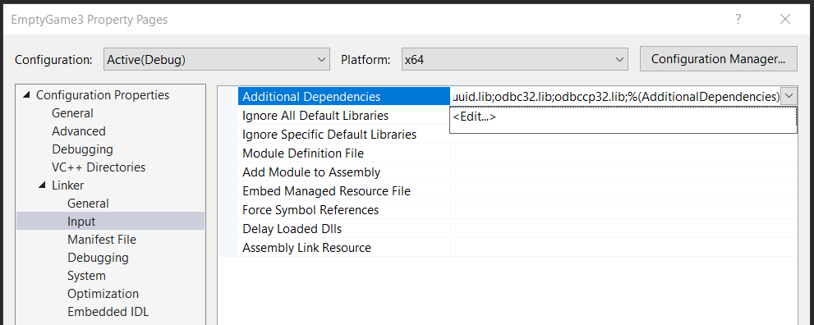
Setting up project
Platform | x64 | x86
Debug
Release
Project > Properties > Linker > Input
Make sure you select the matching platform: x64 (64-bit) or x86 (32-bit)

Slide 7
Setting up project
Platform | x64 | x86
Debug
Release
x64 : 64-bit code, today’s standard
x86 : 32-bit code
Project > Properties > Linker > Input
Make sure you select the matching platform: x64 (64-bit) or x86 (32-bit)

Slide 8
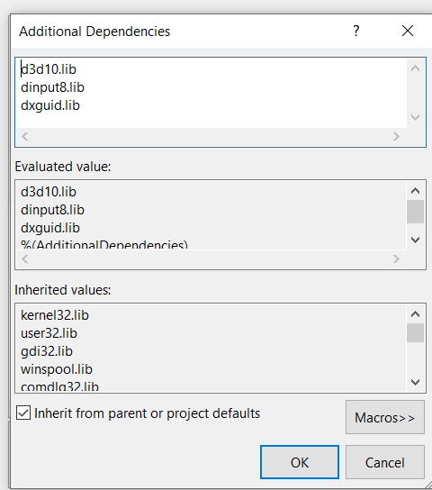
Setting up project
Add d3d10.lib, dxguid.lib,dinput8.lib into list of linked libraries

Slide 9
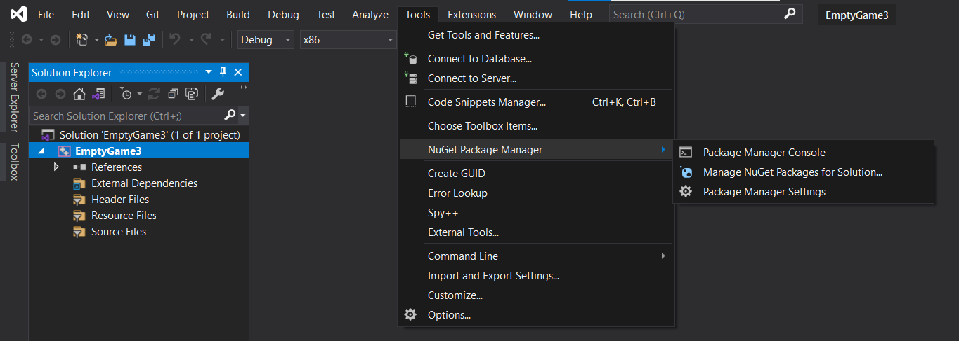
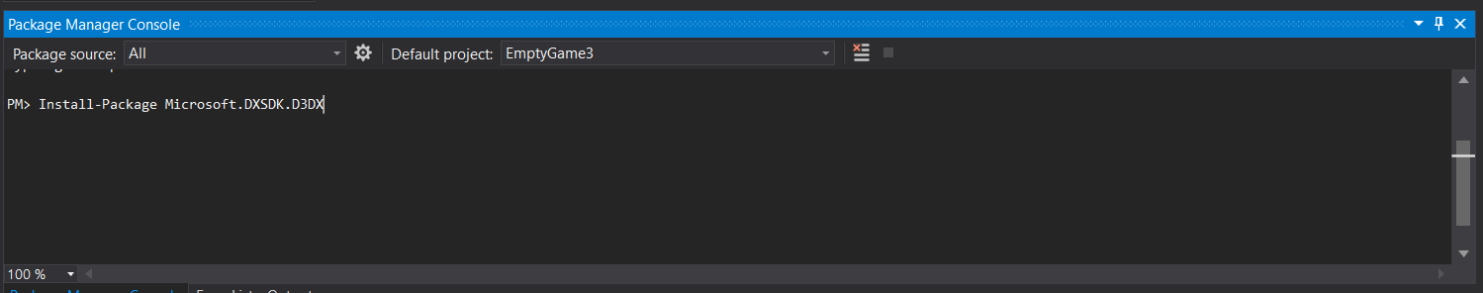
Install D3D10x library
Install-Package Microsoft.DXSDK.D3DX

Slide 10
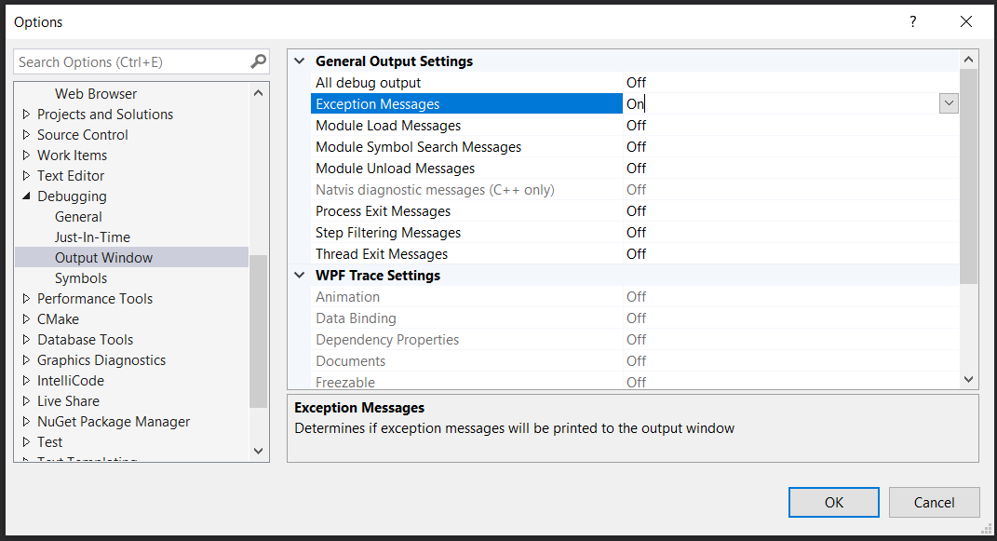
Turn off unwanted debug messages
Tools > Options > Debugging > Output Window
Turn OFF everything under General Output Settings except Exception Messages

Slide 11
DirectX components
Direct3D
DirectX Audio:
DirectMusic
DirectSound
DirectSound3D
DirectInput
DirectPlay: obsoleted

Slide 12
A simple window application

Slide 13
A simple window application
Create a window class
Create a window
Create message loop

Slide 14
Creating a window class
WNDCLASSEX wc;
wc.cbSize = sizeof(WNDCLASSEX);
wc.style = CS_HREDRAW | CS_VREDRAW;
wc.hInstance = hInstance;
wc.lpfnWndProc = (WNDPROC)WinProc;
wc.cbClsExtra = 0;
wc.cbWndExtra = 0;
wc.hIcon = NULL;
wc.hCursor = LoadCursor(NULL, IDC_ARROW);
wc.hbrBackground = (HBRUSH)GetStockObject(WHITE_BRUSH);
wc.lpszMenuName = NULL;
wc.lpszClassName = “GameWindow”;
wc.hIconSm = NULL;
RegisterClassEx(&wc);
Register a new Window Class

Slide 15
Creating a window
WNDCLASSEX wc;
wc.cbSize = sizeof(WNDCLASSEX);
wc.style = CS_HREDRAW | CS_VREDRAW;
wc.hInstance = hInstance;
wc.lpfnWndProc = (WNDPROC)WinProc;
wc.cbClsExtra = 0;
wc.cbWndExtra = 0;
wc.hIcon = NULL;
wc.hCursor = LoadCursor(NULL, IDC_ARROW);
wc.hbrBackground = (HBRUSH)GetStockObject(WHITE_BRUSH);
wc.lpszMenuName = NULL;
wc.lpszClassName = “GameWindow”;
wc.hIconSm = NULL;
RegisterClassEx(&wc);
Specify the function to handle the messages sent to windows of this class – Window Procedure (WinProc)

Slide 16
Creating a window
Create a window from the registered class
HWND hWnd =
CreateWindow(
“GameWindow”, // Window class name
“00 - Intro", // Title
WS_OVERLAPPEDWINDOW, // Window type
CW_USEDEFAULT, // Initial position
CW_USEDEFAULT,
800, // Width
600, // Height
NULL,
NULL,
hInstance, // Program instance
NULL);
if (!hWnd)...
ShowWindow(hWnd,nCmdShow);
UpdateWindow(hWnd);
Display the window AND update the window’s content.

Slide 17
Message loop
MSG msg;
while (GetMessage(&msg, NULL, 0, 0))
{
TranslateMessage(&msg);
DispatchMessage(&msg);
}
return 0;
Sleep until a message is available from the message queue (GetMessage) and send it to the appropriate window.
This message loop is NOT appropriate for real-time game, why?

Slide 18
A simple Direct3D 10 game

Slide 19
Simple Direct3D 10 game
Initiate Direct3D 10
Load a texture and create a sprite
Game loop
Render world
Update world
Limiting max frame rate

Slide 20
Init Direct3D 10
Create device and swap chain
D3D10CreateDeviceAndSwapChain
Create & set render target view to the device
CreateRenderTargetView
OMSetRenderTargets
RSSetViewports
Create and initiate Sprite drawing support library
D3DX10CreateSprite
D3DXMatrixOrthoOffCenterLH
SetProjectionTransform

Slide 21
Load a texture
Load a resource from file
D3DX10CreateTextureFromFile
Retrieve texture interface (i.e convert to texture)
QueryInterface
Create shader resource view for the sprite
CreateShaderResourceView
Initiate a DirectX 10 sprite

Slide 22
Game loop
int done = 0;
while (!done) {
if (PeekMessage(&msg,NULL,0,0,PM_REMOVE)) {
if (msg.message==WM_QUIT) done=1;
TranslateMessage(&msg);
DispatchMessage(&msg);
}
...
Update(dt);
Render();
...
}
PeekMessage: Check if there is a message, get it to msg and remove that message from queue. If there is NO message, return false

Slide 23
Render world
Render a frame
Only READ world’s status (i.e. every object’s status in the world)
Do NOT update world’s status
Clear the back buffer (i.e. clear the window)
ClearRenderTargetView
Compose and set the world transform matrix
Translation: based on sprite location
Scale: based on sprite width and height
Draw a sprite
DrawSpritesImmediate

Slide 24
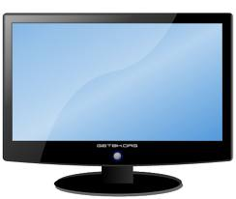
Back buffer & double buffering
Render
ClearRenderTargetView
Back Buffer
Frame Buffer
Screen/Display
Present
DrawSpritesImmediate
Texture
D3DX10CreateTextureFromFile
LoadResources
brick.png

Slide 25
Update world
Update world status
update status (position, speed, etc.) of each object in the game world
Must not contain any code related to rendering
Must not read/write sprite, image, etc

Slide 26
Limiting max frame rate
#define MAX_FRAME_RATE 60
…
ULONGLONG frameStart = GetTickCount();
ULONGLONG tickPerFrame = 1000 / MAX_FRAME_RATE;
while (!done) {
if (PeekMessage(&msg,NULL,0,0,PM_REMOVE)) {
// ...
}
ULONGLONG now = GetTickCount64();
DWORD dt = now – frameStart;
if ( dt >= tickPerFrame) {
frameStart = now;
Update(dt);
Render();
}
else
Sleep(tickPerFrame - dt);
}
1 tick ~ 1millisecond

Slide 27
Limiting max frame rate
now
now
Frame 1
Frame 2
dt
sleep
actual (update + render) time
tickPerFrame
tickPerFrame

Slide 28
Movement
while (!done) {
// ...
Update(dt);
// brick_x++;
Render();
}

Slide 29
Frame-rate dependent movement
while (!done) {
// ...
Update(dt);
// brick_x += brick_vx*dt;
Render();
}

Slide 30

Exercise
Change the brick into a pool ball
Make the ball move and deflect from both dimensions just like a pool ball
Make many balls moving
Challenge: can you make the ball movement more real?
Hint: adding acceleration and friction

Slide 31
Sample 00
DebugOut :
output debug string to console
DebugOutTitle
output a string to the game’s window title
_W(__FILE__) , __LINE__ macros

Slide 32
Window client area
_
X
CLIENT AREA

Slide 33
Window client area
brick_x
2
1

